Slide 1

FILIPINO-AMERICAN MULTI-CULTURAL AND COMMUNITY CENTER OF AMERICA
A SPECIAL PROJECT FOR THE FUTURE GENERATION
BY: FOUNDATION OF FILIPINO ARTISTS AND PARTNERS

Slide 2
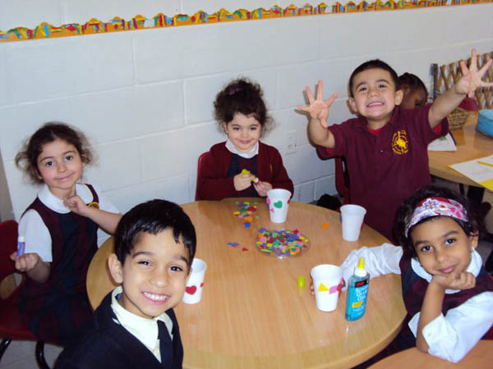
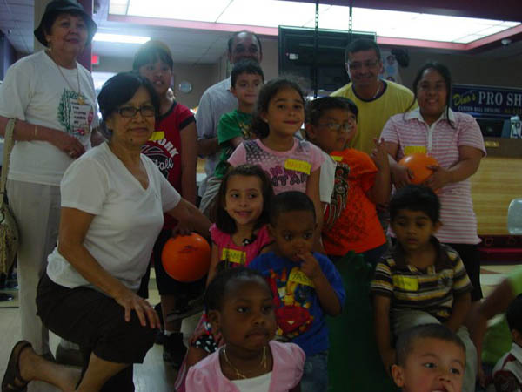
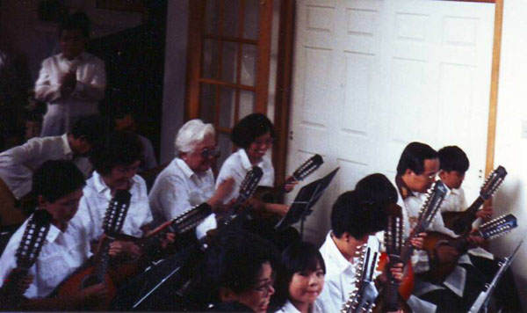
OUR GOAL: CREATE A HAVEN WHERE OUR YOUTH AND SENIORS CAN SOCIALIZE AND PARTICIPATE IN ORGANIZED ACTIVITES.

Slide 3
Why?
-- Kids don’t have a place to go after school
-- Our seniors need physical and mental stimulation
-- The next generation of Filipino Americans need to be taught traditional Filipino values

Slide 4
REPAIR AND/OR BUILD A CENTER

Slide 5
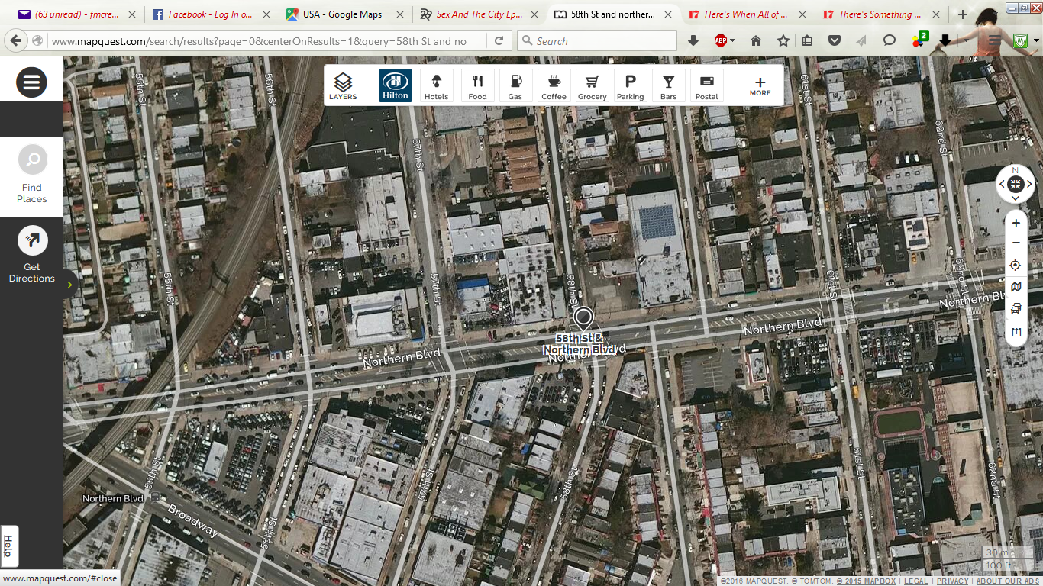
WHERE: AT THE HEART OF THE CITY – ASTORIA, SUNNYSIDE, JACKSON HEIGHTS, LONG ISLAND CITY, AND WOODSIDE

Slide 6
WHEN:
TO BE COMPLETED 2021 OR EARLIER

Slide 7
MORNING – FOR SENIORS FROM 9:30 AM TO 1:30 PM
AFTERNOON – 2:30 PM FOR AFTER SCHOOL PROGRAM ASSISTANCE
EVENING – 7:00 PM FOR SPORTS

Slide 8
HOW DO WE GET THERE?
OUR PLAN: $20 CAMPAIGN
AND CORPORATE AND GOVERNMENT GRANTS

Slide 9
2012 CENSUS:
FILIPINO POPULATION IN AMERICA IS ABOUT 3.6 MILLION
WE NEED TO REACH 8% OF THAT (310,000)

Slide 10
$20 DONATION
FROM 250,000 FILIPINOS
RAISES $5 MILLION.

Slide 11
PROJECTED COST OF THE BUILDING AND RENOVATION IS $3.5 MILLION.

Slide 12
PROJECTED ADMINISTRATIVE COST IS $1.5 MILLION FOR 10 YEARS.

Slide 13
ESCROW ACCOUNT

Slide 14
WHY: TO PRESERVE THE FILIPINO CULTURAL HERITAGE FOR FUTURE GENERATIONS

Slide 15
FFAI PARTNERS
KAGAOAN ENGINEERING, PLLC
BATANGAS VARSITARIAN EAST COAST
KINDING SINDAW
SOCIETY OF PILIPINO AMERICAN ARTISTS
UNITED STAFFING AGENCY

Slide 16
AIDA A. BARTOLOME- Founder
JOHN KAGAOAN- President
Foundation for Filipino Artists, Inc.
http://www.filartist.org
filartists@gmail.com

Slide 17
OUR APPEAL
We need your help. For the cost of 4 cups of coffee, you can help us create a safe environment for Filipino American children and seniors. The Filipino American multi-cultural center of America is the embodiment of that goal - a place for athletics, music, arts, workshops, and historical seminars to benefit the youth and senior of our community.
Please share in our vision and donate now.

